Slide 1

Exploratory Data Analysis of Job Candidate Attributes

Slide 2
About me
As a B.Tech student majoring in Electronics and Communication Engineering (ECE) at Rajiv Gandhi University of Knowledge Technologies, I've refined my proficiency in mathematics, programming, and analytical thinking. Despite my specialization in ECE, I am deeply intrigued by the potential of data science to glean valuable insights from extensive datasets, fostering innovation and informed decision-making. To augment my skills, I have actively pursued supplementary coursework and engaged in self-directed study in data science, completing various online courses, participating in hackathons, and undertaking personal projects.
Although I lack formal employment experience in data science, I have independently executed projects and contributed to academic endeavors centered around data analysis and machine learning. These hands-on experiences have effectively merged theoretical knowledge with practical application, thereby enhancing my problem-solving prowess. For further details regarding my academic background, projects, and skill set, I invite you to explore my LinkedIn profile (https://www.linkedin.com/in/divyasree-peddadevara342/) and GitHub repository (https://github.com/Peddadevara-Divyasree).

Slide 3
Objective of the project
The Objective of the Project is to examine a dataset encompassing details about graduates, with the aim of revealing insights into their career paths, potential earnings, and the determinants affecting their employment outcomes. By conducting thorough data exploration, statistical analysis, and hypothesis testing, the project endeavors to offer valuable insights beneficial for educational institutions and career planning endeavors.

Slide 4
Summary of the Data
The dataset comprises information about graduates, including demographics, educational backgrounds, and career-related attributes. It encompasses numerical data such as salary, academic scores, and personality test scores, as well as categorical variables like gender, specialization, and job designation. The dataset offers a comprehensive view of graduates' profiles, enabling analysis of employment trends, salary distributions, and potential correlations between various factors influencing career outcomes.

Slide 5
Exploratory Data Analysis:
Data Cleaning and Manipulation Steps
Handling date columns
Converting to datetime
Handling missing values
Filling missing values
Removing outliers
Interquartile Range
Renaming columns
Merging dataframes
Selecting columns
Concatenating dataframes
Filtering rows based on conditions

Slide 6
Exploratory Data Analysis: Univariate Analysis Steps
In our exploratory data analysis (EDA), we conducted a comprehensive univariate analysis encompassing Probability Density Functions (PDFs), histograms, box plots, and countplots to understand numerical and categorical variables. Additionally, we identified outliers within each numerical column, crucial for data integrity. By scrutinizing probability and frequency distributions of numerical data, we gained insights into their statistical characteristics and potential anomalies. Similarly, examining the frequency distribution of categorical variables allowed us to grasp the prevalence of each category, providing context for further analysis. This multifaceted approach to EDA equipped us with a deeper understanding of the dataset's structure, paving the way for informed decision-making and subsequent analytical endeavors.

Slide 7
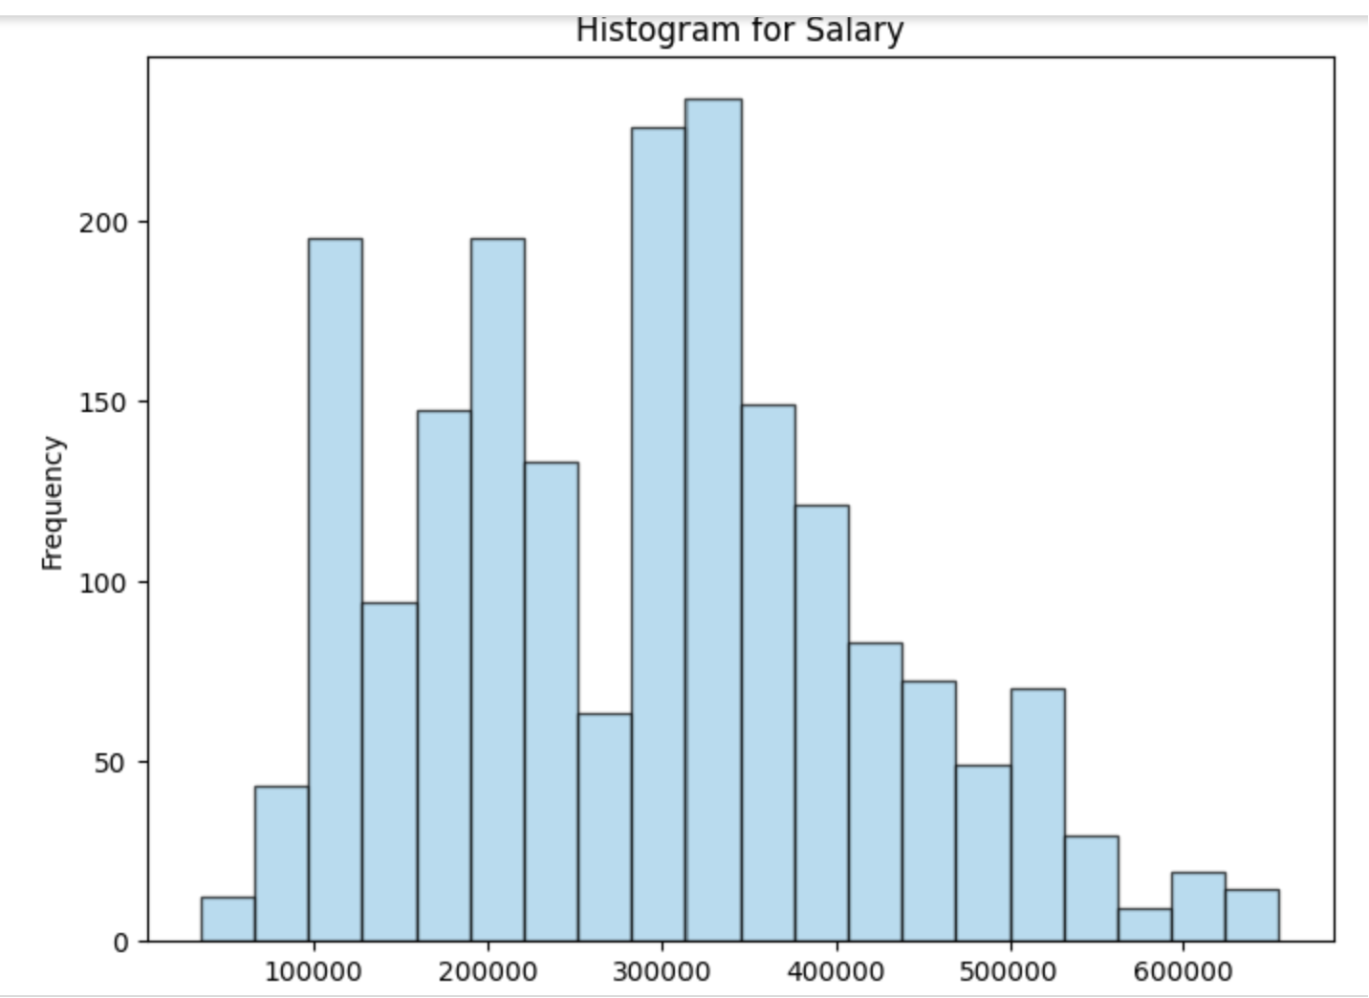
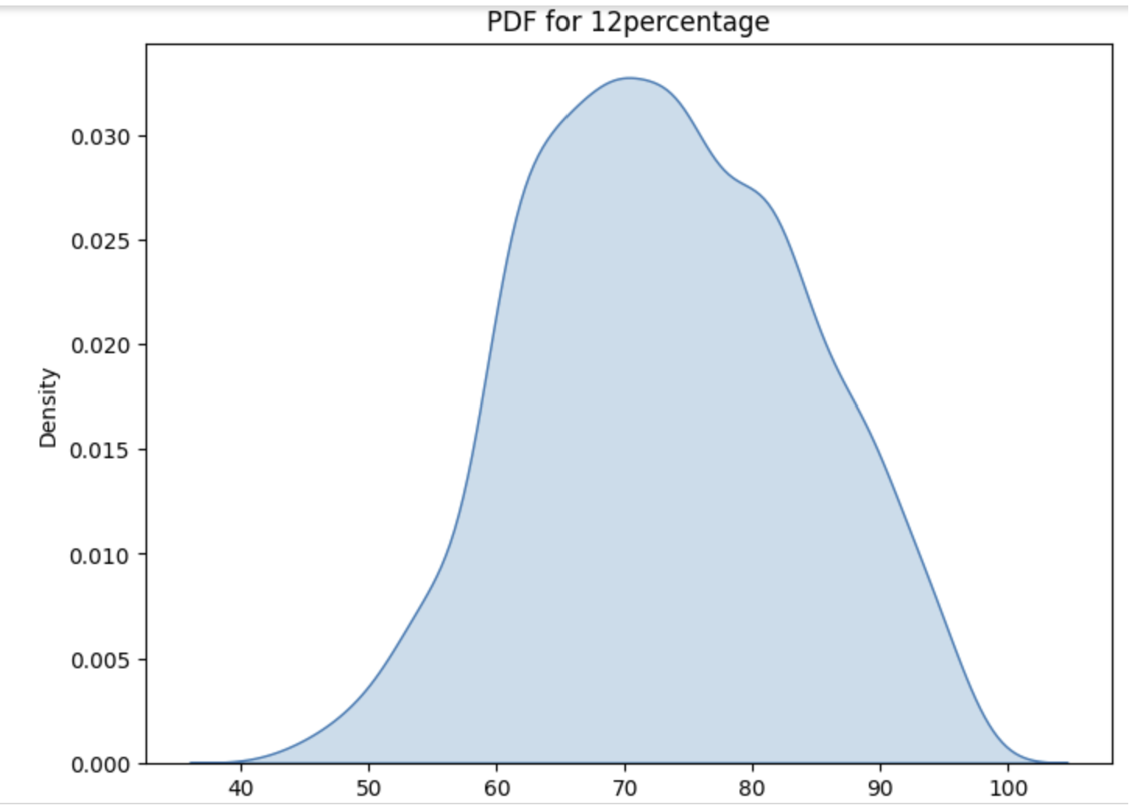
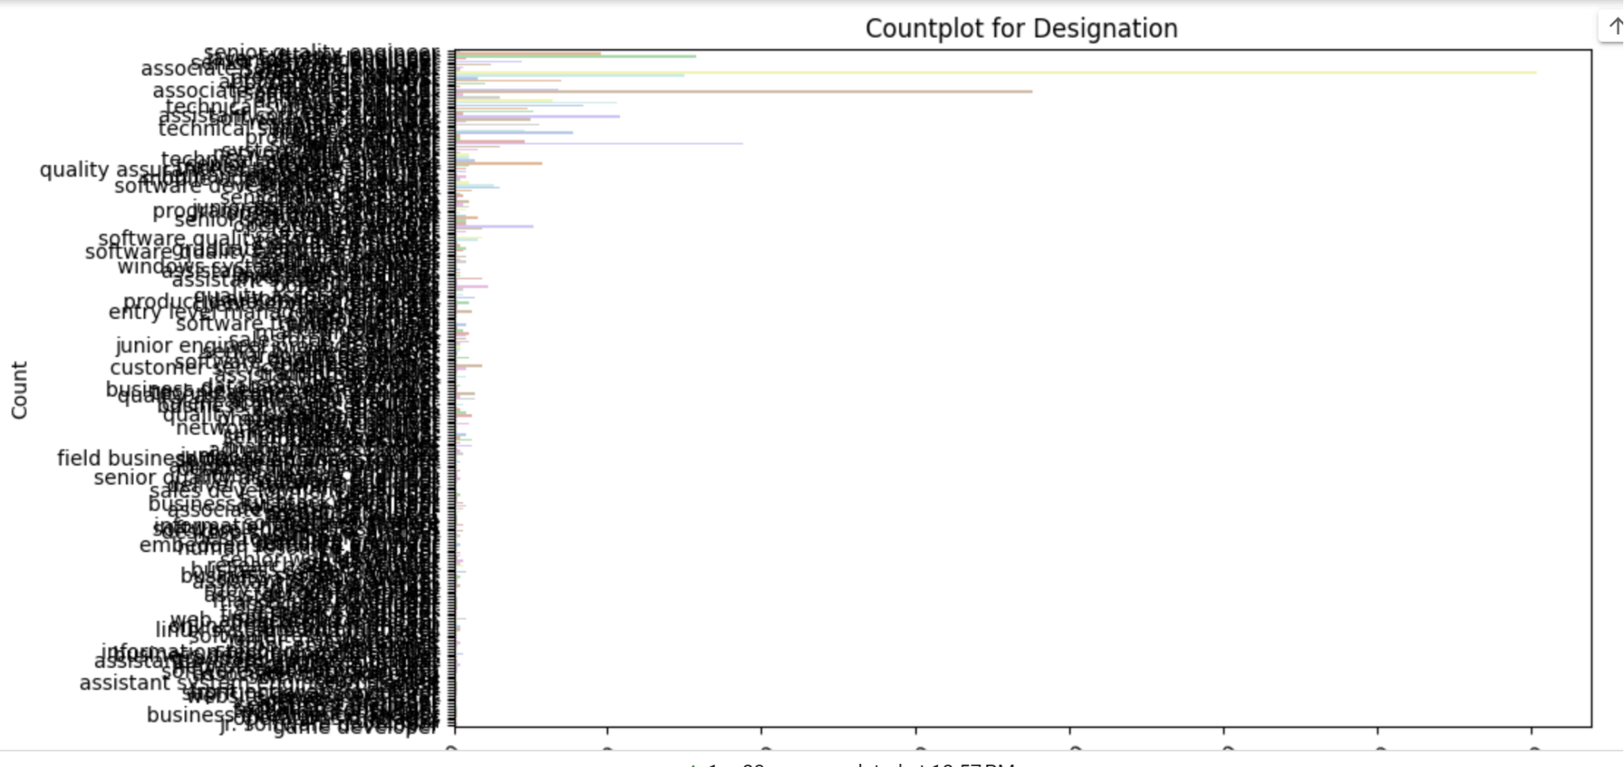
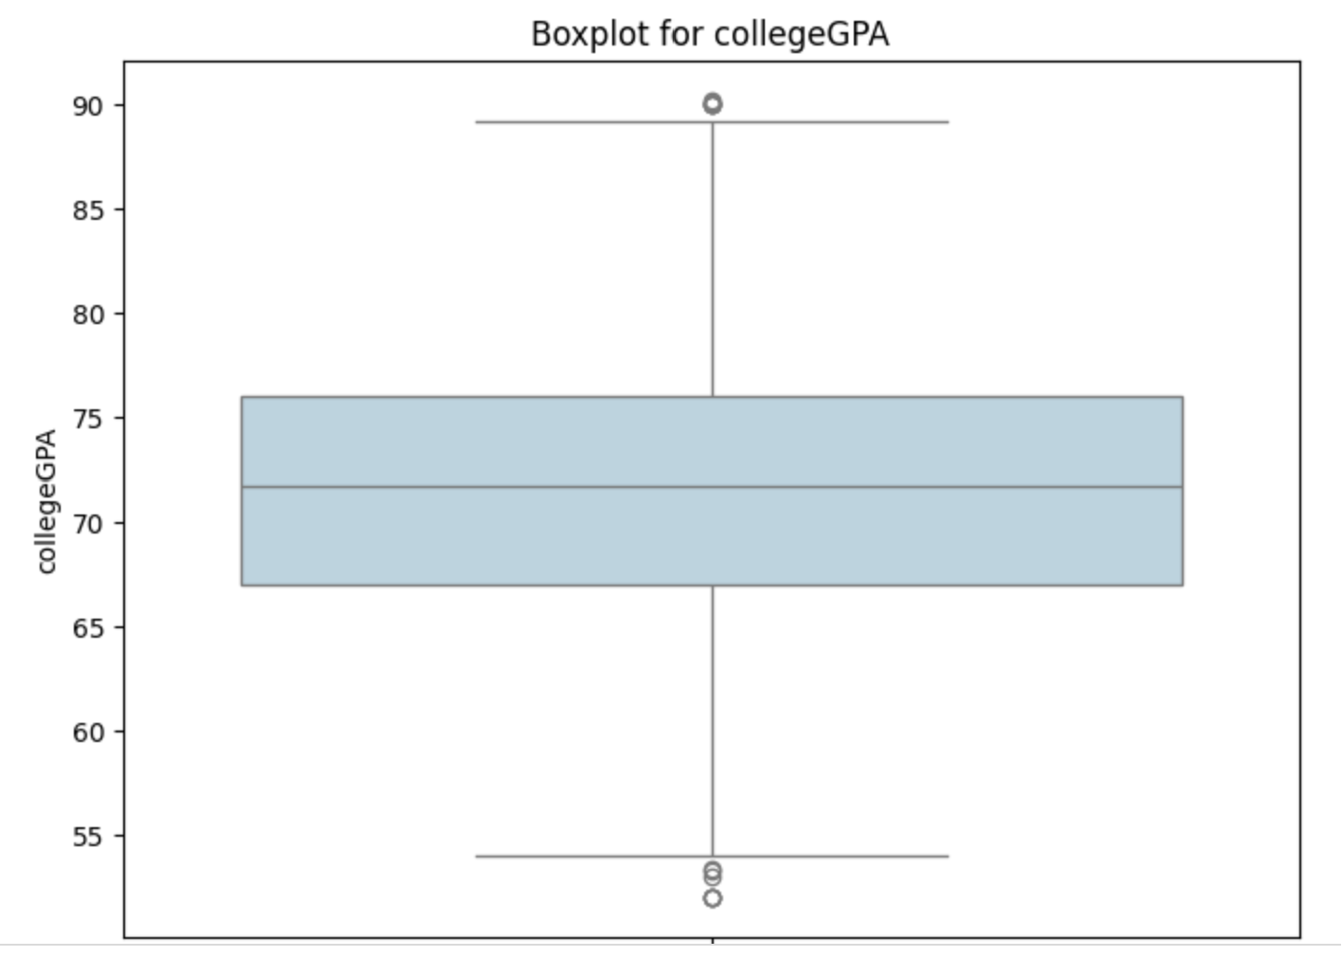
Exploratory Data Analysis: Univariate Analysis Steps

Slide 8
Exploratory Data Analysis: Bivariate Analysis Steps
In our exploratory data analysis (EDA), we engaged in bivariate analysis to uncover relationships between numerical columns using scatter plots, hexbin plots, and pair plots, facilitating insights into correlations and dependencies. Furthermore, we elucidated patterns between categorical and numerical columns through swarm plots, box plots, and bar plots, revealing variations and trends across different categories. Additionally, we explored relationships between categorical variables using stacked bar plots, discerning associations and dependencies among various categorical factors.

Slide 9
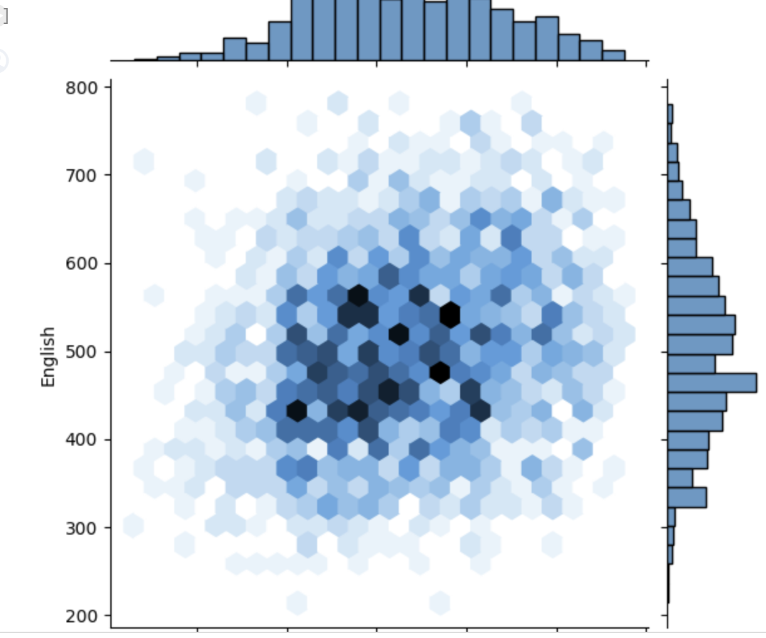
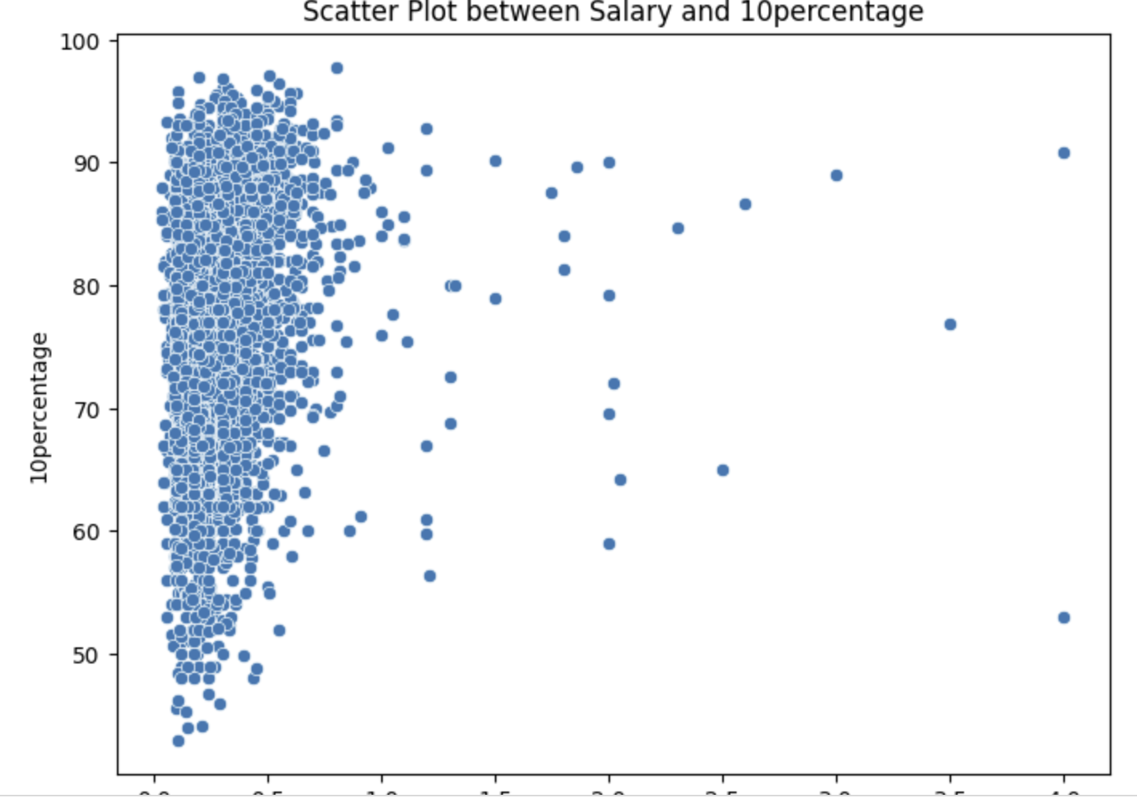
Exploratory Data Analysis: Bivariate Analysis Steps
This holistic approach to EDA provided a comprehensive understanding of inter-variable dynamics, enabling us to derive meaningful insights and inform subsequent analytical decisions with a nuanced understanding of the dataset.

Slide 10
Exploratory Data Analysis: Research Questions
To make sure the claim holds up, we looked at the salaries of Computer Science Engineering grads in jobs like Programming Analyst, Software Engineer, Hardware Engineer, and Associate Engineer. We also ran some number tests to see if there's a big difference in the types of jobs guys and girls pick. By digging deep into the data, we wanted to confirm if the claim about salary ranges is true and if there are any noticeable differences or trends in what guys and girls prefer to specialize in. This method helped us give strong insights into what salaries to expect and any gender-related trends in specialization choices among Computer Science Engineering grads.

Slide 11
Conclusion
In this project, we took a close look at a bunch of data to learn about things like how much people get paid, what kind of education they have, and what jobs they prefer. We used different methods to dig into the data, like looking at one thing at a time (univariate) and comparing two things together (bivariate). We checked out how numbers are spread out, found any weird data points, and figured out if there are connections between different pieces of information. We also checked out if there are any links between things like gender and what people studied in school. Overall, what we found gives us a better picture of the data, helps us understand what's happening in society, and can help make better decisions in related areas.

Slide 12

THANK YOU

